Slide 1
Lesson 13 Files And Databases:
The Ever Present Source of Pure Knowledge

Slide 2
Wholeness Statement
File structures make storing and retrieving persistent data efficiently. A file structure is an organization of data within disk blocks. The Absolute field of pure consciousness contains the infinite organizing power of natural law.

Slide 3
Files
Java provides convenient tools for reading and writing files.
Java supports reading and writing text streams and binary streams.
In this lesson we focus on the API for text streams.
Java represents each character with the UTF-16 encoding.
Need to close files when finished.
Prior to j2se5.0: Pass the File to a FileReader then pass from FileReader to a BufferedReader
J2se5.0: Pass the File to a Scanner

Slide 4
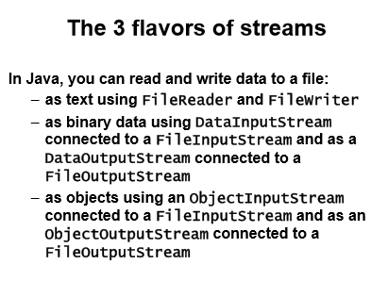

Slide 5
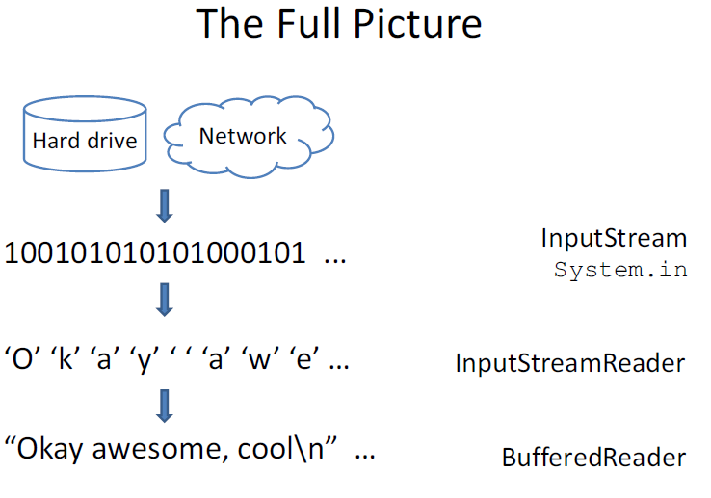
COURTSEY: MIT

Slide 6
InputStream
InputStream is a stream of bytes
– Read one byte after another using read()
• A byte is just a number
Data on your hard drive is stored in bytes
Bytes can be interpreted as characters, numbers..
InputStream stream = System.in;

Slide 7
InputStreamReader
Reader is a class for character streams
– Read one character after another using read()
InputStreamReader takes an InputStream and converts bytes to characters
Still inconvenient
– Can only read a character at a time
new InputStreamReader(stream)

Slide 8
BufferedReader
BufferedReader buffers a character stream so you can read line by line
– String readLine()
new BufferedReader(
new InputStreamReader(System.in));

Slide 9
User Input
InputStreamReader ir = new InputStreamReader(System.in); BufferedReader br = new BufferedReader(ir);
br.readLine();

Slide 10
FileReader
FileReader takes a text file
converts it into a character stream
FileReader(“PATH TO FILE”);
Use this + BufferedReader to read files!
FileReader fr = new FileReader(“readme.txt”); BufferedReader br = new BufferedReader(fr);

Slide 11
FileReader Code
import java.io.BufferedReader;
import java.io.FileReader;
import java.io.IOException;
public class ReadFile {
public static void main(String[] args) throws IOException{
// Path names are relative to project directory
FileReader fr = new FileReader("./src/readme");
BufferedReader br = new BufferedReader(fr);
String line = null;
while ((line = br.readLine()) != null) {
System.out.println(line);}br.close();
}}

Slide 12
Example( Read file using scanner)
File f = new File("word_test.txt");
Scanner s = new Scanner(f);
// Scanner s = new Scanner(new File("word_test.txt"));
String word;
try {
while( (word = s.next()) != null){
System.out.println(word);
}
}
catch(Exception e){ }
s.close();

Slide 13
Example(Read File using BufferedReader)
File f = new File("word_test.txt");
FileReader fr = new FileReader(f);
BufferedReader reader =
new BufferedReader(fr);
// To read many lines, loop like this:
String line;
while((line = reader.readLine()) != null) {
//do something with the line
}
reader.close();

Slide 14
Example
File file = new File("scores.txt");
PrintWriter output = new PrintWriter(file);
// Write formatted output to the file
output.print("Ram Sudhan ");
output.println(90);
output.print("Jane Smith ");
output.println(85);
System.out.println("Write Successfully");
// Close the file
output.close();

Slide 15
More about I/O
http://java.sun.com/docs/books/tutorial/essential/io/

Slide 16
Demo code
ReadData.java
WriteData.java
FileReadWriteDemo

Slide 17
Main Point 1
Reading a File in Java is accomplished by using a FileReader (or Scanner). Writing to a File is accomplished by using a FileWriter. More generally, "input" in human life is handled by the senses; "output" is handled by the organs of action; both have their source in the field of pure creative intelligence.

Slide 18
Interacting With A Database
JDBC provides an API for interacting with a database using SQL
part of the jdk distribution
To interact efficiently with a database, the database vendor's driver is used for communication between the JVM and the database
For demos, Java comes with the jdbc-odbc bridge

Slide 19
Database connection
Java
application
Resultset
JDBC
API
JDBC-ODBC
driver
ODBC
driver
SQL query
Tables
database

Slide 20
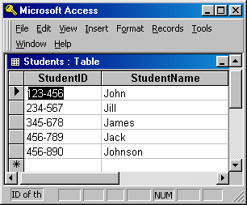
Java
application
Database connection
JDBC
API
JDBC-ODBC
driver
ODBC
driver
Select StudentName from Students

Slide 21
Steps in setting up and using JDBC
Register the data source
– tells the operating system where to look for the database
Control Panel -> Administrative Tools -> Data Sources (ODBC) ->
User DSN tab -> Add -> Microsoft Access Driver -> Finish
Then put in the name of the data source (use this name in the Java program, see Step 2). Continue with 'Database select' which tells it 'where' to find the database file
Determine the database url that will tell JDBC the name of the data source and the driver to use

Slide 22
Coding steps for JDBC
Assemble your database url that will tell JDBC the name of your data source– typically, store this database url as a constant
In your code, first load the driver .
Then create a connection object – you pass in the url at this stage. Typically try to reuse the connection object because it is costly to open up this connection, especially when you do it frequently.
Create a Statement object.
Prepare a String consisting of an SQL query, and pass it to the Statement instance, using either executeQuery(String sql) or updateQuery(String sql).

Slide 23
Cont…
6. Return value of these query methods in a ResultSet instance. A ResultSet encapsulates the rows of data that have been read.
7. When you have finished with the database, close the Statement instance with the close() method.

Slide 24
ResultSet
A ResultSet encapsulates the rows of data that have been read
A cursor is initially positioned before the first row in the ResultSet
Loop through using the next() method (returns a boolean) to read the rows in the table
Read a row by specifying the column names you wish to look at.
The getString(columnName) method returns the value in the current row of the result set having the specified column name, if that value is of String type
Some other options are getInt, getDouble, getDate

Slide 25
Connecting to a database with JDBC
Register the JDBC driver with the driver manager in Java8
by importing UCanAccess Jar Files in your project.
No need to give the following statement in Java8.
Class.forName("sun.jdbc.odbc.JdbcOdbcDriver"); // Before Java8
2. Establish a database connection.
cn=DriverManager.getConnection(
"jdbc:ucanaccess://D:/myfirstDB/EmpDB.accdb");
Connection dbConn =
DriverManager.getConnection("jdbc:odbc:cscourses"); // Before Java8
3. Create a Statement object and execute an SQL statement.
Statement stat = dbConn.createStatement();
ResultSet courses = stat.executeQuery
( "SELECT CourseID, CourseName from courses");
stat.close();

Slide 26
Connecting to a database with JDBC (cont.)
4. Process the result.
while (courses.next()) //iterate through all records
{
System.out.println(courses.getString("CourseID")
+ ” - " + courses.getString("CourseName")
}
5. Close the database connection.
dbConn.close( )

Slide 27
import java.sql.*;
public class dbconnection
{
String url = "jdbc:odbc:studentinfo";
Connection con;
Statement stmt;
public void Close() {…}
public void Connect() {…}
public ResultSet DoQuery (String query) {…}
public void DoUpdate(String query) {…}
}
Name of the
odbc connection
For selection queries
For insert, delete and
update queries

Slide 28
Example of using the dbconnection class
// load data from the database
dbconnection dbconnect = new dbconnection();
dbconnect.Connect();
ResultSet rs;
rs=dbconnect.DoQuery("Select * from StudentInfo");
try {
while (rs.next()) {
id = rs.getString("StudentID");
name = rs.getString("StudentName");
System.out.println(”studentid =” + id);
System.out.println(”studentname =” + name );
}
} catch (SQLException ex) {
System.err.println("error in database connection");
}
dbconnect.Close(); //close database connection

Slide 29
SQL Queries
SELECT
used to read values from a table
INSERT
used to insert a new row
DELETE
used to remove one or more rows
UPDATE
used to change values in already-existing rows

Slide 30
SELECT
SELECT custid, password
FROM Customer
WHERE custid = '1'
This statement locates all records in the Customer table in which the custid column has value '1', and returns rows restricted to the two columns custid and password

Slide 31
INSERT
INSERT INTO ShippingAddresses
(custid,street,city,state,zip)
VALUES('1','B St','Fairfield','IA','52556')
This statement inserts a new record into the ShippingAddresses table, placing values 1, B St, Fairfield, IA, and 52556 in the custid, street, city , state, and zip fields, respectively

Slide 32
DELETE
DELETE FROM Company
WHERE comp_name = 'Pepsi‘
This statement deletes from the Company table all rows in which the comp_name field is equal to 'Pepsi'

Slide 33
UPDATE
UPDATE Employees
SET salary = salary * 1.10
WHERE dep_code = 32
This statement changes the value in the salary field to 1.10 times the original value, for all records in which the dep_code equals 32

Slide 34
To enhance flexibility, we want to separate the User Interface (UI) from the Business Logic and the Database (DB).
Presentation Layer
UI
Business Logic
Layer
Persistence Layer
DB
Business logic is the programming that manages communication between an end user interface and a database.
The purpose of your application's persistence layer is to use a session at run time to associate mapping data and a data source in order to create, read, update, and delete persistent objects using queries and expressions, as well as transactions

Slide 35
Add a New Data Source to ODBC
Start -> Settings -> Control Panel -> Administrative Tools ->
Data Sources (ODBC)
In the ODBC Data Source Administrator
Click add button
In the Create New Data Source window
Select “Microsoft Access Driver (*.mdb)”
Click finish button
In the ODBC Microsoft Access Setup window
Enter the Data Source Name
The name of the connection in the program
Click select button
In the Select Database window
Browse until the correct .mdb file is found (click on it)
Click OK button (three times in three windows)

Slide 36
Testing frameworks for Java
There are several testing frameworks available for Java. The most popular ones are JUnit and TestNG.
We are focusing at JUnit.

Slide 37
Contd..
A JUnit test is a method contained in a class which is only used for testing. This is called a Test class.
To write a test with the JUnit 4.x framework you annotate a method with the @org.junit.Test annotation.
In this method you use an assert method, typically provided by the JUnit or another assert framework, to check the expected result of the code execution versus the actual result. These method calls are typically called asserts or assert statements.

Slide 38
JUnit
Unit testing is when a programmer write test code to verify units of code.
The size of a unit isn’t precisely defined, so we’ll view a unit as a small bit of code that exhibits some useful behavior in your system. A unit on its own usually doesn’t represent complete end-to-end behavior. It instead represents some small subset of that end-to-end-behavior.
In Java, we write our unit tests in Java. We run these unit tests through JUnit, a tool that marks our tests as passing or failing.

Slide 39
Here are a few whens and whys for writing unit tests:
You just finished coding a feature and want to ensure that it works as you expect.
You want to document a change so that you and others later understand the choices you coded into the system.
You need to change code and want to make sure your forthcoming changes
don’t break any existing behavior.
You want to understand the current behavior of the system.
You want to know when third-party code no longer behaves as you expect.

Slide 40
Contd..
Most important, good unit tests increase our confidence to ship your production system. We still need to conduct integration and/or acceptance tests, which verify end-to-end behavior.
Remember-
Arrange, Act, and Assert Your Way to a Test
Naming is important

Slide 41
Test execution order
JUnit assumes that all test methods can be executed in an arbitrary order. Well-written test code should not assume any order, i.e., tests should not depend on other tests.

Slide 42
Demo program

Slide 43
CONNECTING THE PARTS OF KNOWLEDGE WITH THE WHOLENESS OF KNOWLEDGE

Slide 44
Since Java is an OO language, it supports storage and manipulation of data within appropriate objects.
To work with real data effectively, Java supports interaction with external data stores (databases) through the use of various JDBC drivers and the JDBC API.

Slide 45
3. Transcendental Consciousness
is the field of truth and total knowledge, in seed form, about everything in the Universe (i.e., pure knowledge).

Slide 46
4. Wholeness moving within itself : In Unity Consciousness, the final truth about life is realized in a single stroke of knowledge, i.e., life is the expression of the self-interacting dynamics of my own pure consciousness, the field of pure bliss.

